Slide 1
AI and ML based trash collecting boat/bot: Manual and Auto Mode
Group 1:
Sumedh Kamat
Snehal Vasanakar
Prasanna Gramopadhye
Akshay Gaikwad
Project Guide:- Prof. Mrs. Radha A. Ranjekar, Assistant professor
Electrical Department, PVG’s College of Engineering, Pune

Slide 2
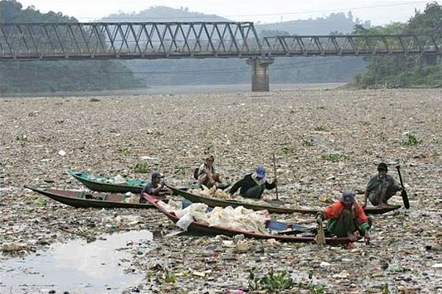
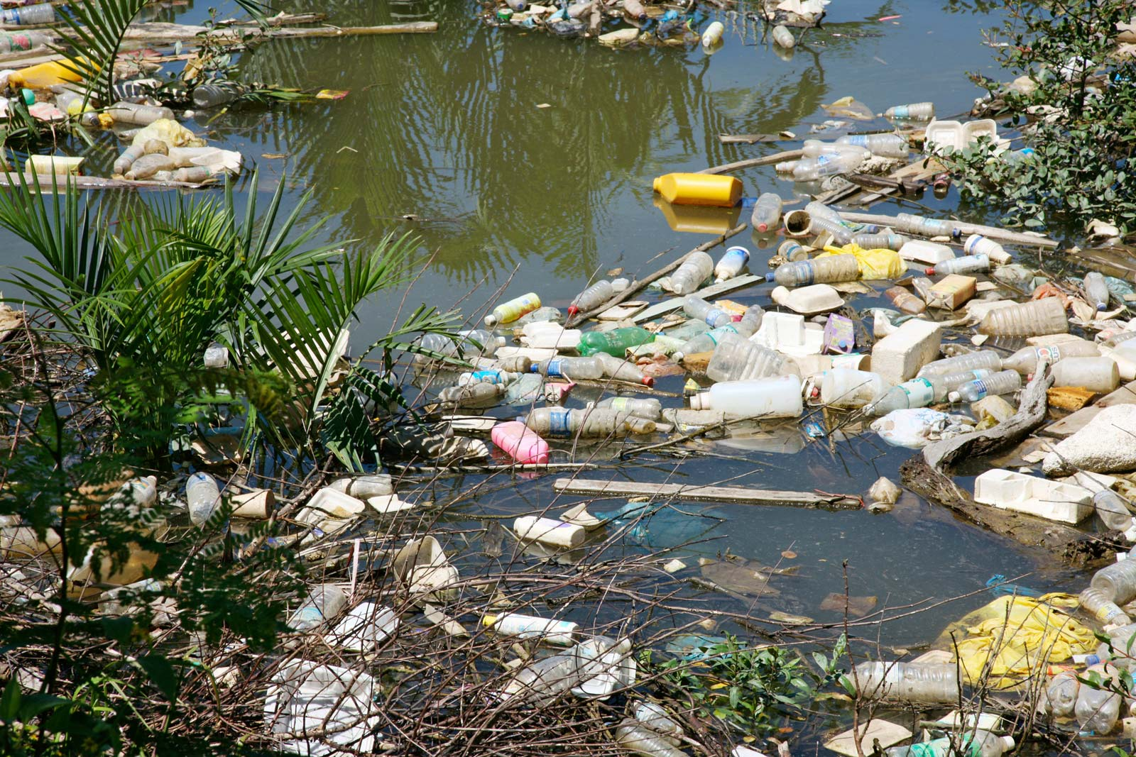
Problem Statement
Water pollution with floating garbage is getting more and more serious in many countries causing a major environmental problem that endangers the lives of river inhabitants.
Contemporaneous methods find it difficult to manage the volume of solid waste generated by the growing urban population.

Slide 3
Proposed System
Proposed system is an unmanned water trash collector boat, which will collect floating garbage inside it.
There are 2 modes of operation for this boat
Manual control mode
Automated control mode
Trash gets accumulated inside boat in flow when it reaches to the trash.

Slide 4
Workflow
Video streamline captured by camera, is sent to rasp-pi for processing of video frames at 30 FPS rate
Rasp-pi then uses a pretrained model of trash on each frame to compute object detection in the background (It detects if there is any trash in that frame)
If it finds any, draws a bounding box around that detection on that particular frame.
Results then are sent to the moderator’s screen for further controlling in manual mode and in case of automation mode, processor computes it’s actions accordingly on it’s own.

Slide 5
Trash boat navigation and Waste Collection
Once we detect the targeted trash, commands are given to boat via wifi (VNC) using laptop/suitable controller.
Instantaneous actions are provided to boat motors via raspberry pi to navigate towards the trash (by controlling person in manual mode or by automation)
Once the boat is completely filled with trash, it is then driven to nearest station for unloading of trash.

Slide 6
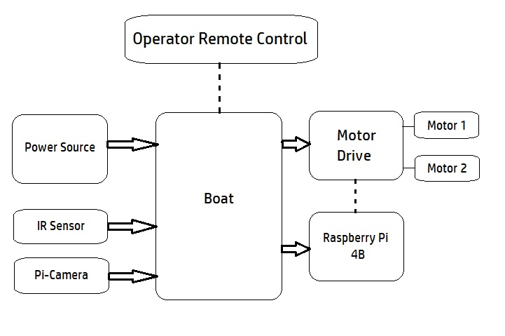
Block Diagram

Slide 7
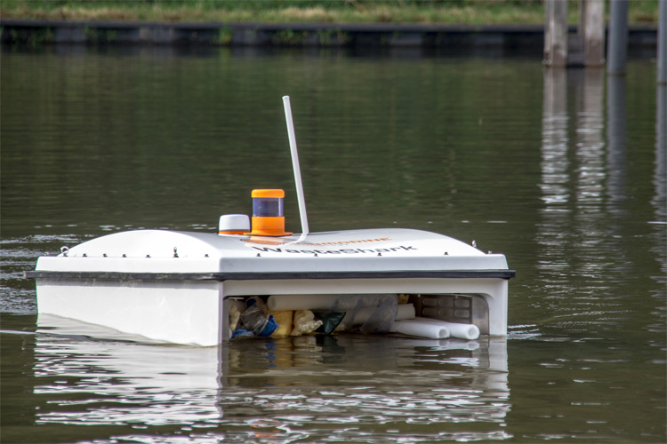
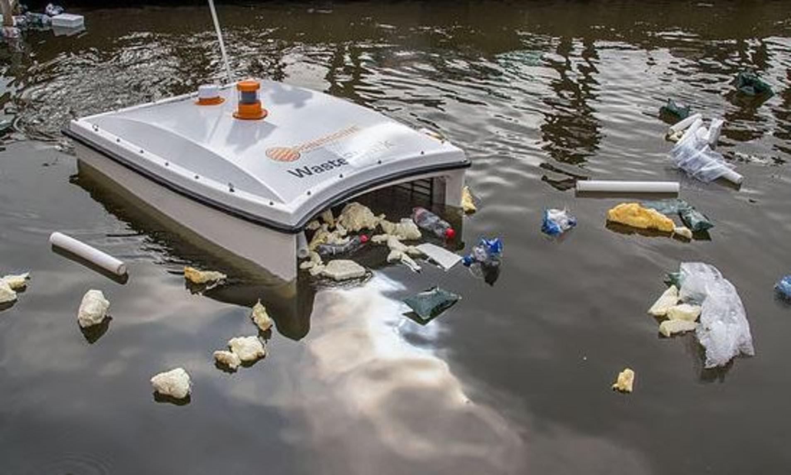
Literature review
A US based company ‘Wasteshark’ has already achieved a manually driven trash collector boat, our main aim will be to maximize the efficiency of boat and provide a way cheaper option for it.
Reference Links:
https://youtu.be/dBA0-W4E0Gk https://youtu.be/f9Y2yFj0890

Slide 8
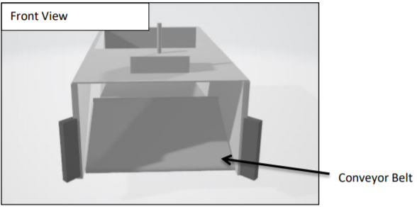
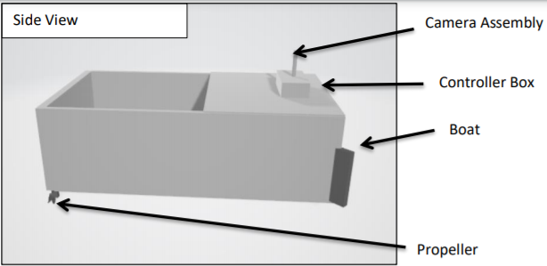
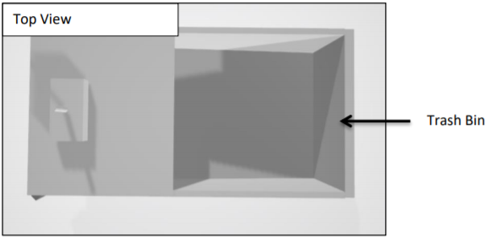
Proposed Design
Approximate dimensions :
L:B:H = 3.5 : 2.2 : 2.4 (in feet)

Slide 9
Dependencies and Challenges
Controlling of boat would be a challenge in high current water flow, especially in the rainy days when the water flow of drainage system is high.
Range for communication between user and system can be problematic.
Project has major dependency on the controller being used for speed, accuracy and water resistant behavior aka physical properties.
Unsupervised learning model dependencies are quite vulnerable to our boat as it can not differentiate untrained variables such as rocks,etc.

Slide 10
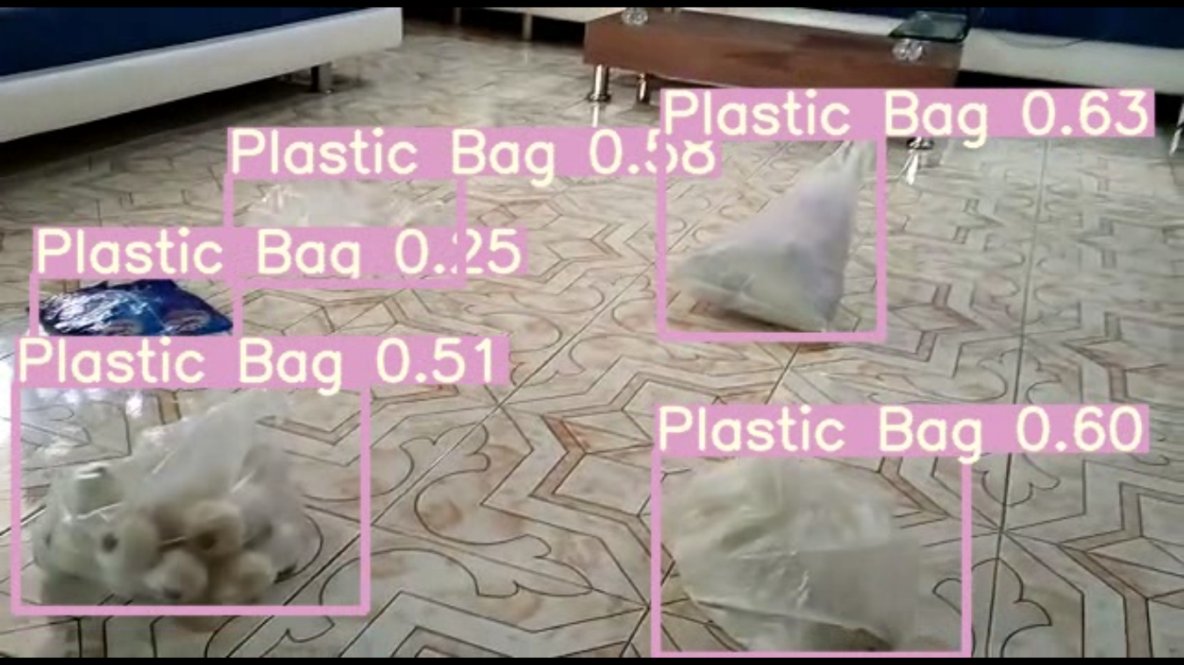
Results on Trash Detection
Above image shows the successful detection of plastic waste on our custom trained model (Numbers denote confidence level)

Slide 11
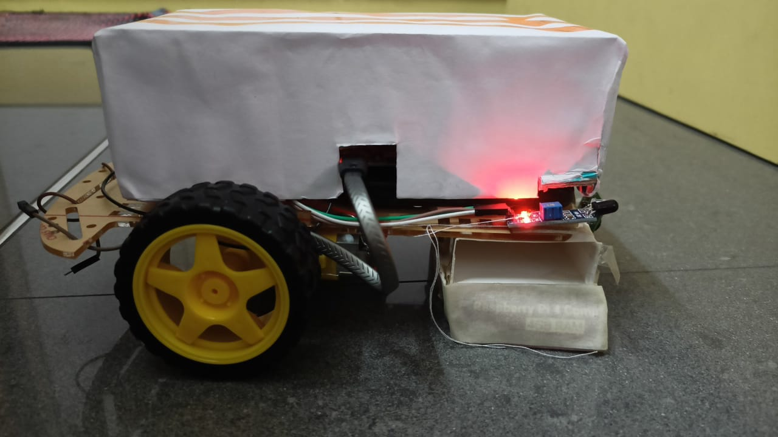
Images of model : Right side View

Slide 12
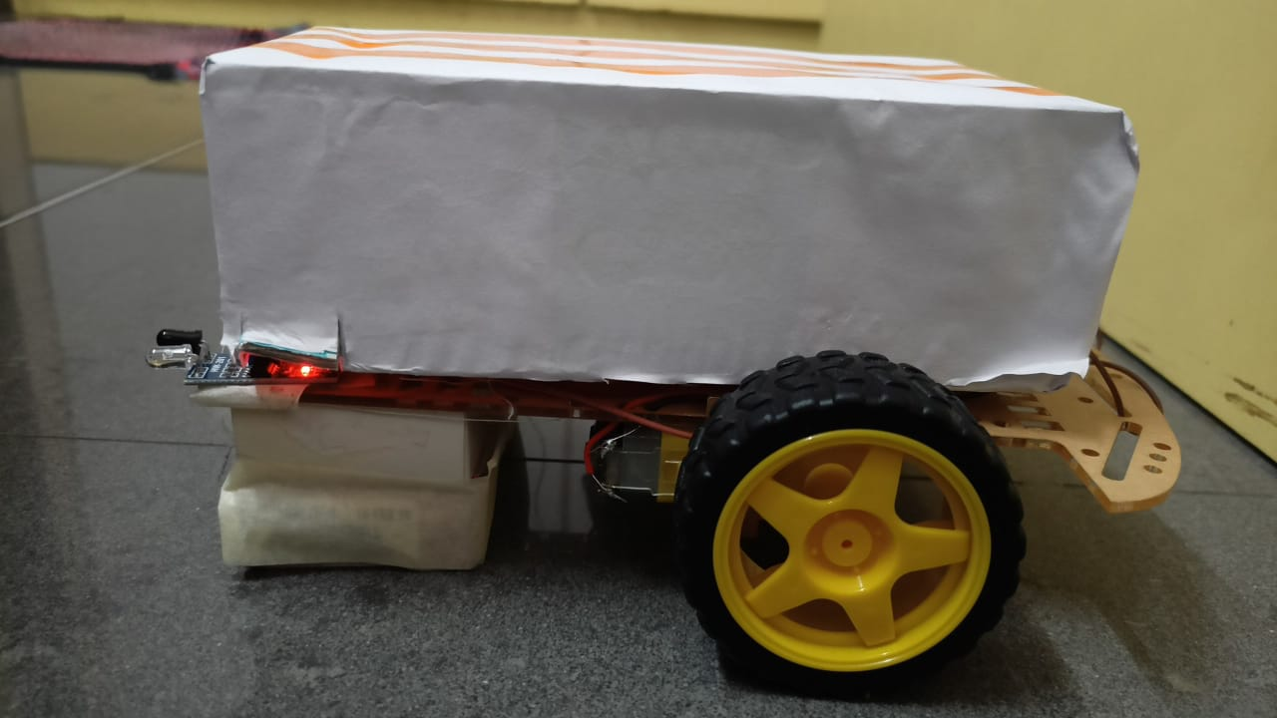
Images of model : Left side View

Slide 13
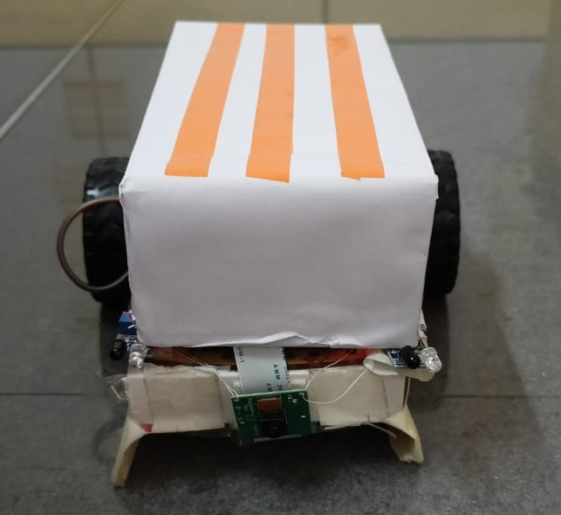
Images of model : Front View

Slide 14
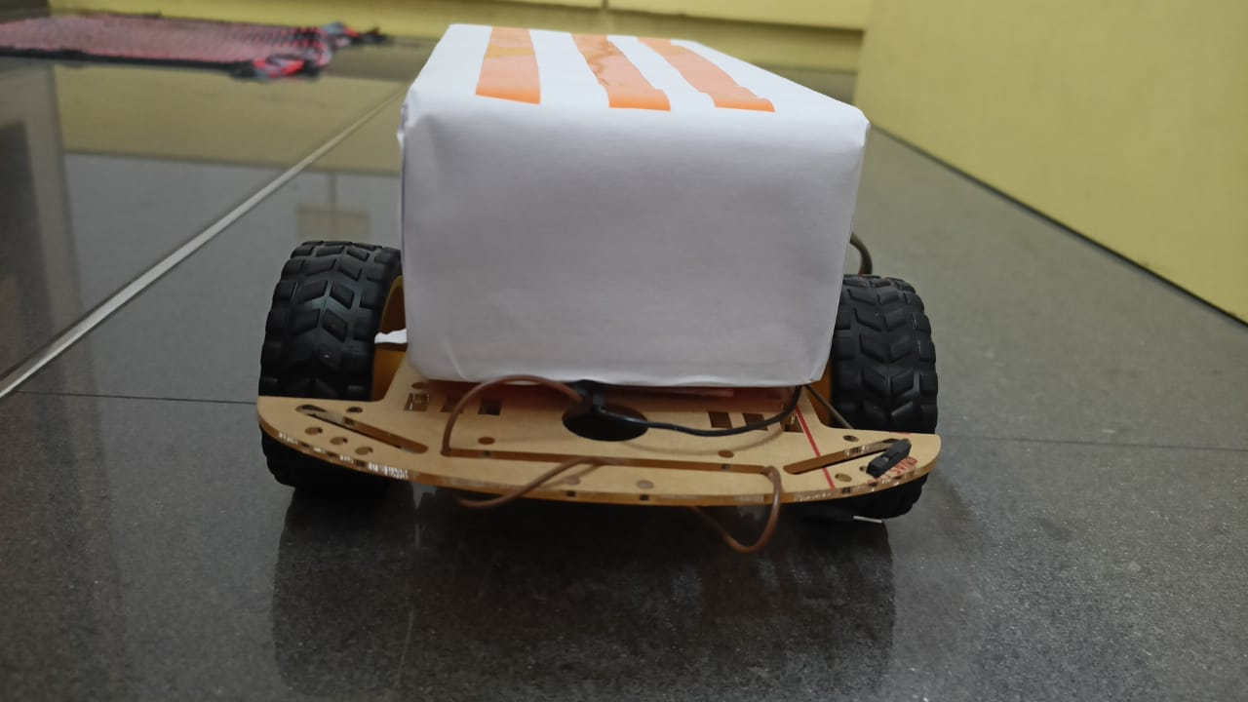
Images of model : Backside View

Slide 15
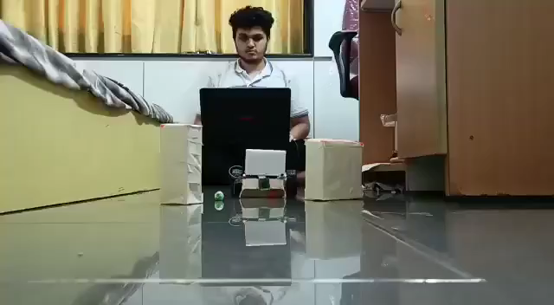
Final results 1: Manual Mode

Slide 16
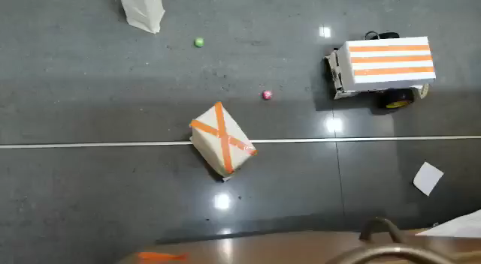
Final results 2: Manual Mode

Slide 17
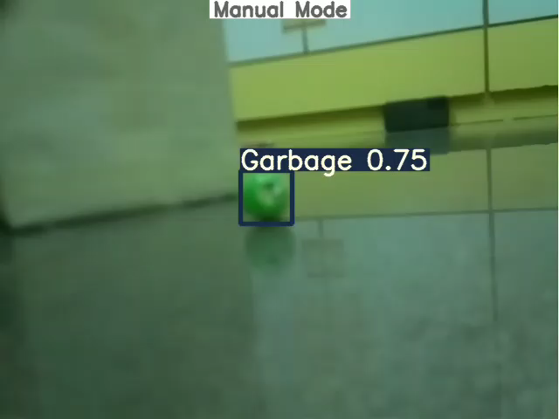
Final results 3: Manual Mode

Slide 18
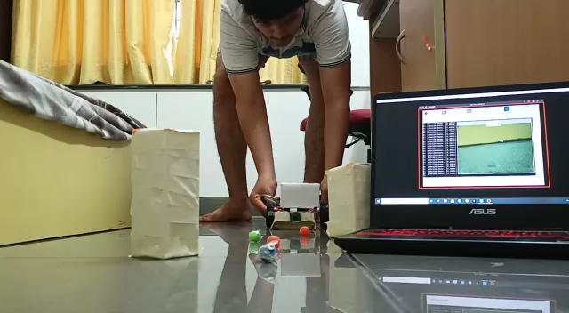
Final results 1: Auto Mode

Slide 19
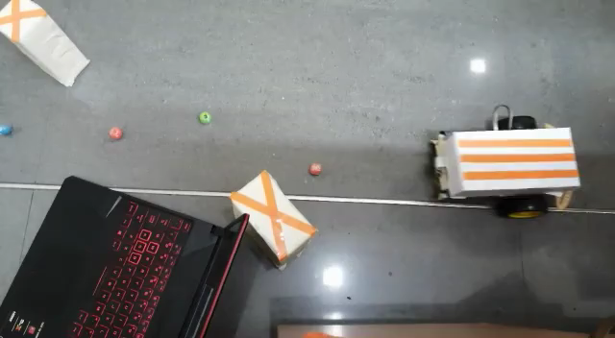
Final results 2: Auto Mode

Slide 20
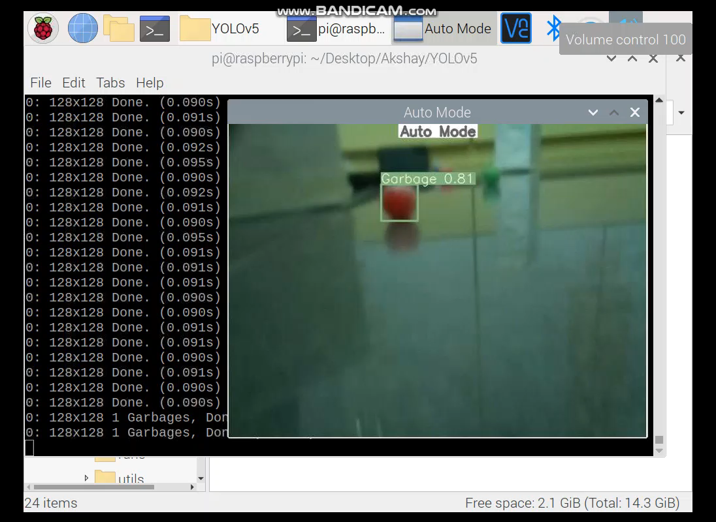
Final results 3: Auto Mode

Slide 21
References
1) Computer Vision and Pattern Recognition using YOLO algorithm : https://arxiv.org/abs/1506.02640
2) Artificial Intelligence Enabled Robotic Trash Boat to Drive and Harvest Floating Trash from Urban Drain by P.Elavarasi, S.A.Meenuppriya, M.Monira, P.Priya, P.Reni. Department of ECESRM TRP Engineering College, Trichy, TamilNadu, India.
3) Raspberry pi controller & sensors : https://tutorials-raspberrypi.com/raspberry-pi-sensors-overview-50-importantcomponents/#wireless
4) Yolo Research paper and Information: https://github.com/pjreddie/darknet

Slide 22
Thank you!

Slide 23
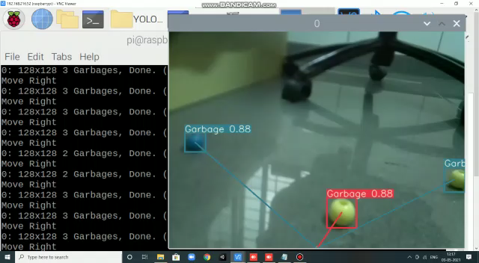
Auto Mode Algo 1: Nearest Trash detection

Slide 24
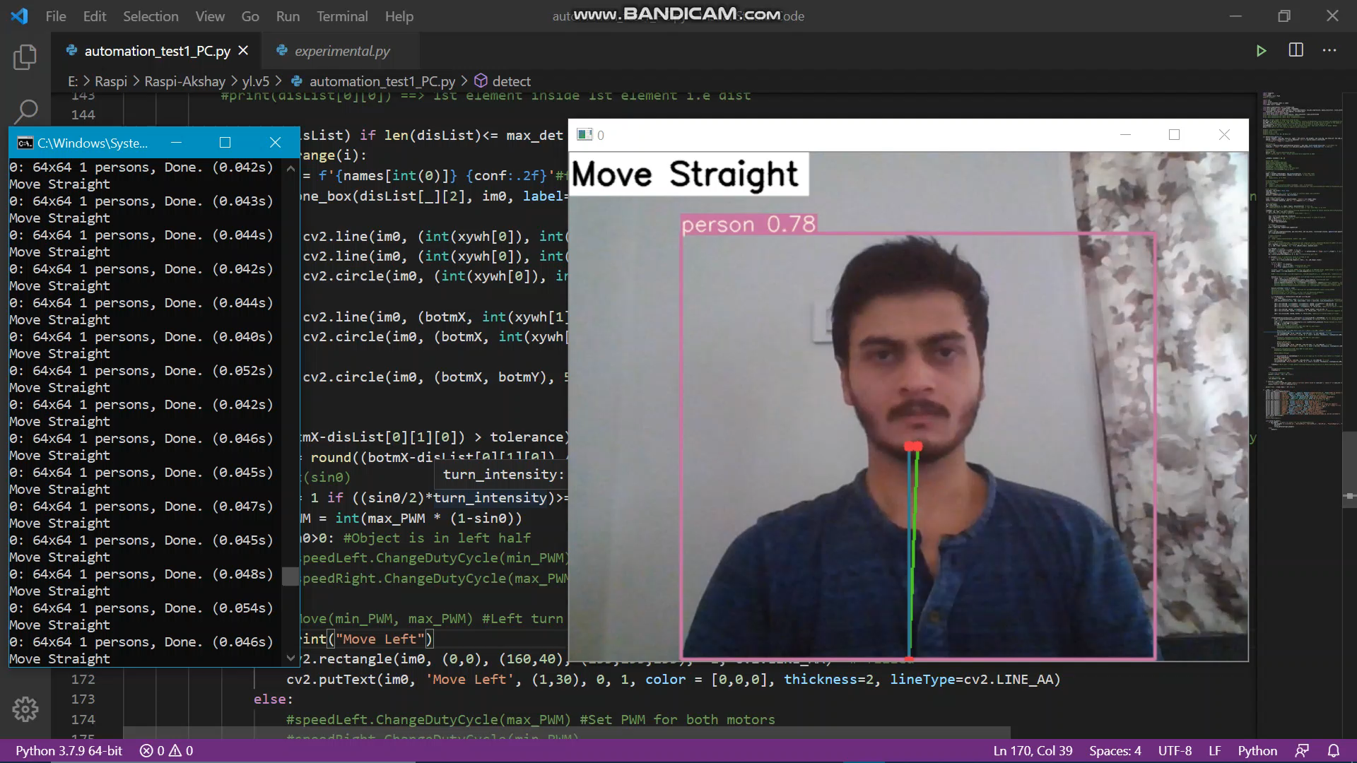
Auto Mode Algo 2: Turning Instructions

